Slide 1
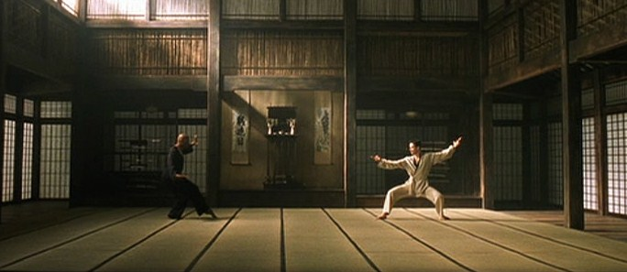
Initiation au Coding Dojo – part 1
INRIA Saclay – 20/03/2012
André Fonseca

Slide 2
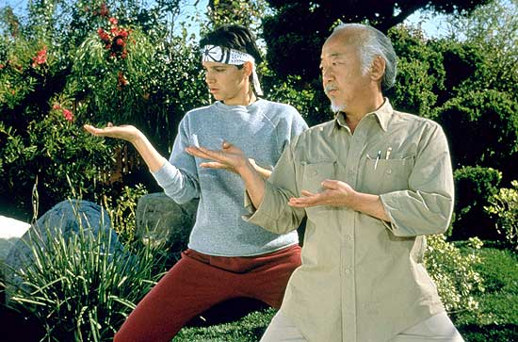
In order to learn a martial art, you should train…

Slide 3
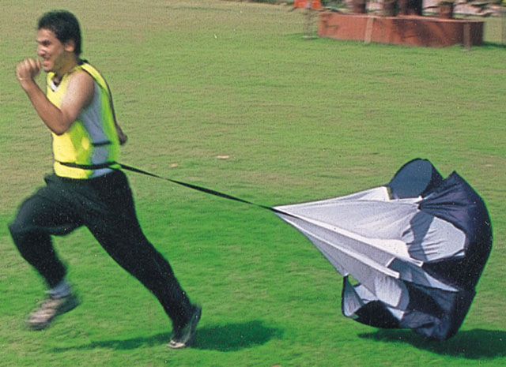
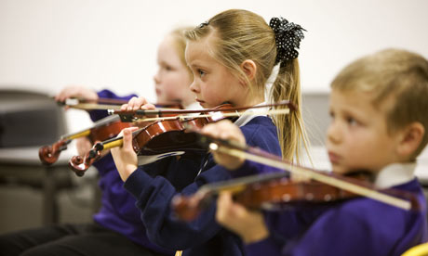
Also for playing an instrument or practicing a sport, you should train… a lot!

Slide 4
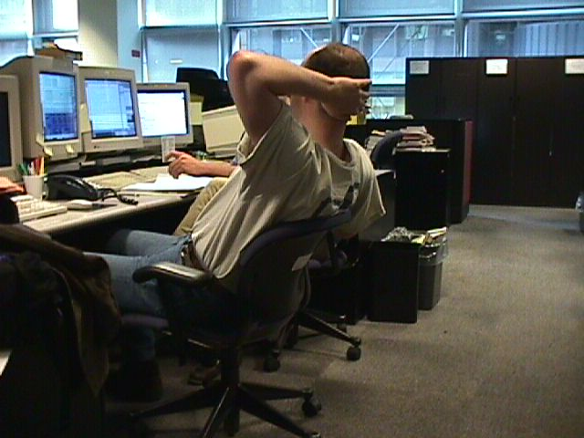
But programmers do NOT train!

Slide 5
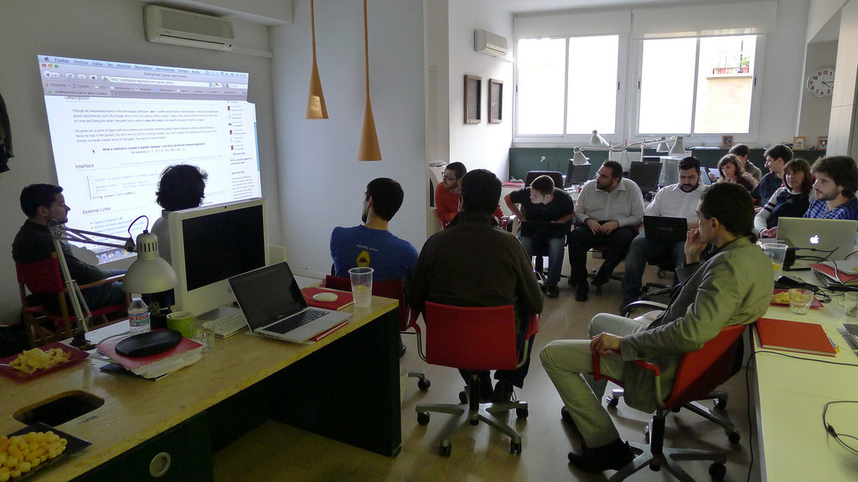
What is Coding Dojo?
It is meeting that programmers can practice, learn and work together on a specific challenge.

Slide 6

What is Coding Dojo?
It is meeting that programmers can practice, learn and work together on a specific challenge.

Slide 7
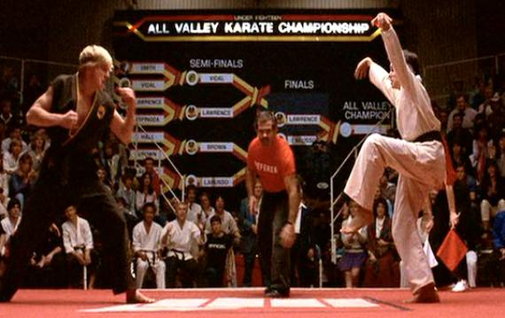
It is not a exibition!
Be humble, please! ☺

Slide 8
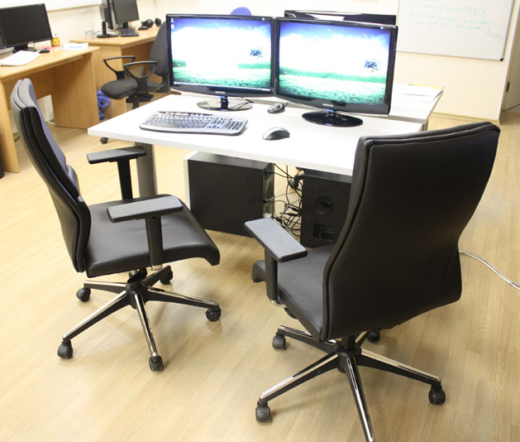
Basic concepts
Pair programming
- Navigator
- Driver

Slide 9
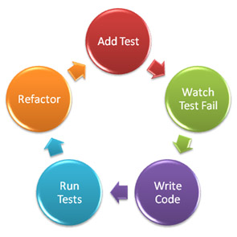
Basic concepts
Test driven development (TDD)

Slide 10
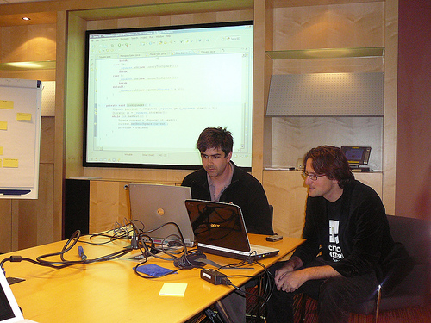
2 different styles:
Kata
- Fixed Navigator/Driver
- Solve before, show it alive
- Feedback only when it is necessary

Slide 11
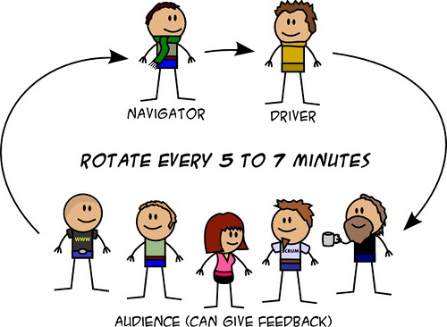
2 different styles:
Randori

Slide 12
Retrospective
What was good? ☺
What was bad? ☹
What we have learn?

Slide 13
Reference
http://codingdojo.org

Slide 14
Initiation au Coding Dojo – part 2
INRIA Saclay – 20/03/2012
André Fonseca

Slide 15
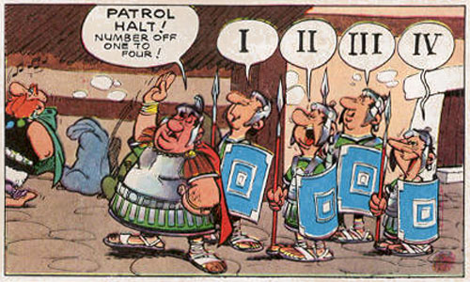
Our first Kata!
Ruby + Rspec
Solve the problem of the « Roman Numerals »

Slide 16
But, at first…
The Ruby language:

